Slide 1
EEE213 Power Electronics and Electromechanism
Tutorial (lecture 1 to 5)

Slide 2
Problem 2.1
Lecture 2
A single-phase bridge rectifier is required to supply an average voltage of 110V to a resistive load R=10 Ω. The main supply is 220V RMS. Determine
1)The rms value of the input voltage for the rectifier and then the turns ratio of the transformer;
2)The voltage and current ratings of the diodes;
3)The power rating of the transformer;
4)The power consumed by the load;
5)The THD of the line current.

Slide 3
Problem 2.2
Lecture 2
2.2 A battery charger is supplied by a single-phase bridge rectifier. The battery voltage is E=20V and the capacity is 10Ah. The current-limiting resistor is 10ohm. The input voltage is 30V RMS. Draw the waveforms and then calculate
1)The conduction angle of a diode;
2)The average charging current;
3)The charging time;
4)The power dissipated on R;
5)The peak reverse voltage across a diode.

Slide 4
Problem 3.1
Lecture 3
A three-phase bridge rectifier supplies a ripple-free current I₀=10A and an average voltage V₀=110V to the load.
Assume v_{A}=V_{m}sinωt.
1)Determine the rms value of the phase voltage;
2)Draw the current and voltage waveforms for D1, D3, D5;
3)Draw the current waveform for phase A and determine the rms value;
4)Determine the diode ratings.

Slide 5
Problem 3.2
Lecture 3
The single phase bridge rectifier is supplied from a 120V, 60Hz source. The load resistance is R=500ohm.
a) Design a capacitive filter so that the ripple factor of the output voltage is less than 5%;
b) With the value of capacitor C in part a), calculate the average load voltage V_{dc}.

Slide 6
Problem 4.1
Lecture 4
A full converter is connected to a 100V-50Hz supply v_{s}. The load is purely resistive with R=10 ohm.
(1) Draw the waveforms for the output voltage, the current, and the line current for a firing angle .
(2) Express the line current i_{s} in a Fourier series;
(3) Determine the THD of the line current;
(4) Determine the displacement power factor cosϕ and the line power factor f_{P};
(5) If the firing angle is α = π/3, calculate V₀, THD, cosϕ , f_{P} and the power dissipated by the load.

Slide 7
Problem 4.2
Lecture 4
Repeat the previous question when a very large inductor is put into series with the resistor.

Slide 8
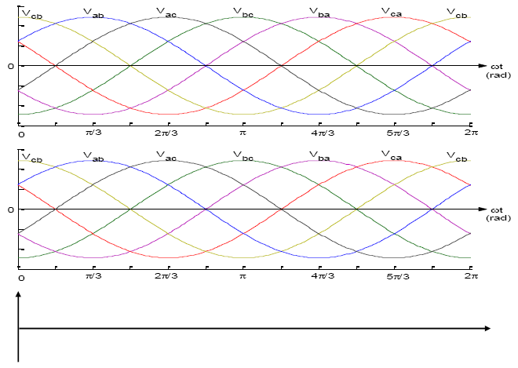
Problem 5.1
Lecture 5
A three-phase full bridge SCR rectifier supplies a DC power to an RL load. The output current ripple is negligible. The firing angle is 45°.
Draw the waveforms for the output voltage, the voltage across SCR1, and the line current of phase A.

Slide 9
Problem 5.2
Lecture 5
A resistive load R=10 in series with a very large inductor is supplied by a bridge rectifier connected to a three-phase power supply with a phase voltage of 100V. It is required to obtain an average voltage of 150V. Calculate
1)The firing angle needed;
2)The average current;
3)The rms output voltage and current;
4)The power consumed by R;
5)The average and rms values of a thyristor current;
6)The rms line current;
7)The input power factor.
Draw the waveforms for the output voltage, a thyristor voltage and a line current.

Slide 10
Problem 2.1
A single-phase bridge rectifier is required to supply an average voltage of 110V to a resistive load R=10ohm. The mains supply is 220V RMS. Determine
1)The rms value of the input voltage for the rectifier and then the turns ratio of the transformer;
2)The voltage and current ratings of the diodes;
3)The power rating of the transformer;
4)The power consumed by the load;
5)The THD of the line current.

Slide 11
Problem 2.2
A battery charger is supplied by a single-phase bridge rectifier. The battery voltage is E=20V and the capacity is 10Ah. The current-limiting resistor is 10ohm. The input voltage is 30V RMS. Draw the waveforms and then calculate
1)The conduction angle of a diode;
2)The average charging current;
3)The charging time;
4)The power dissipated on R;
5)The peak reverse voltage across a diode.

Slide 12
Problem 2.2
A battery charger is supplied by a single-phase bridge rectifier. The battery voltage is E=20V and the capacity is 10Ah. The current-limiting resistor is 10ohm. The input voltage is 30V RMS. Draw the waveforms and then calculate
1)The conduction angle of a diode;
2)The average charging current;
3)The charging time;
4)The power dissipated on R;
5)The peak reverse voltage across a diode.

